Slide 1
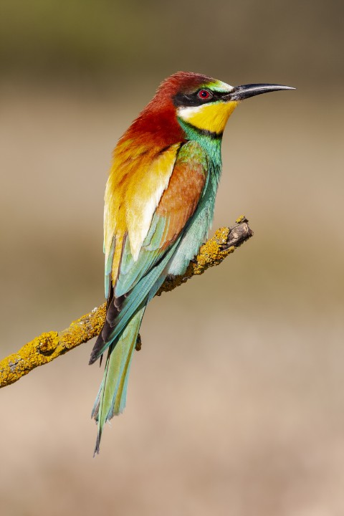
Bird Migration PPT
"Birds are a miracle because they prove to us there is a finer, simpler state of being which we may strive to attain. "

Slide 2
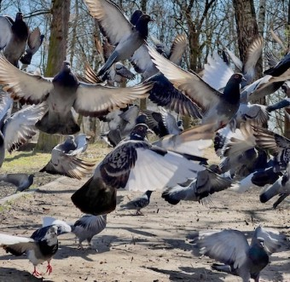
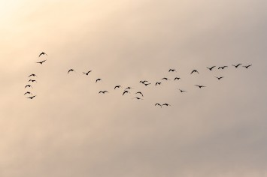
Introduction to Bird Migration
Bird migration refers to the seasonal movement of birds between their breeding and non-breeding grounds. It is a remarkable phenomenon observed worldwide.

Slide 3
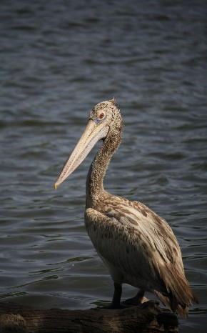
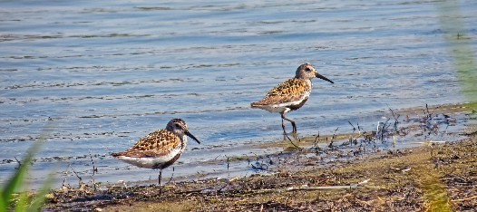
Reasons for Migration
Birds migrate to find abundant food sources, suitable breeding habitats, and favorable climate conditions.
Migration also helps them escape harsh winters and avoid resource competition.

Slide 4
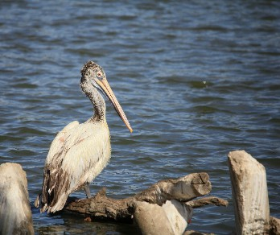

Types of Bird Migration
Birds undertake either short-distance or
long-distance migration. Short-distance migration involves traveling within the same continent, while long-distance migration covers intercontinental journeys.

Slide 5
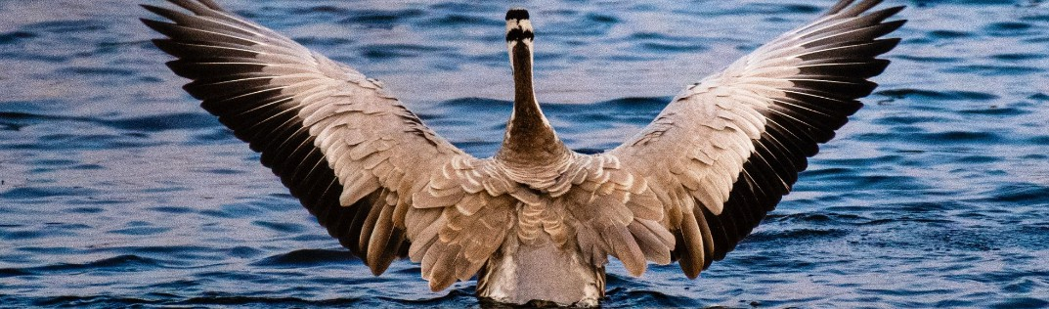
Navigation and Orientation
Birds use a combination of celestial cues, landmarks, magnetic fields, and innate instincts to navigate and orient themselves during migration.

Slide 6
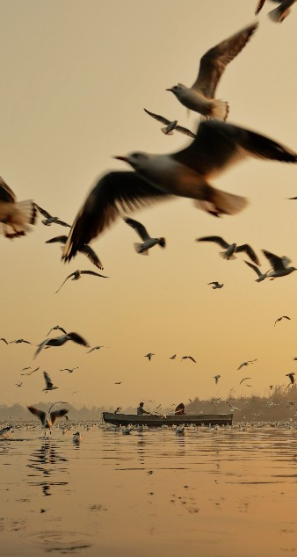
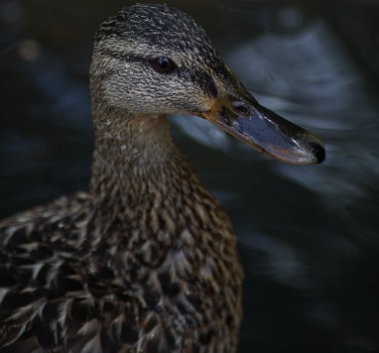
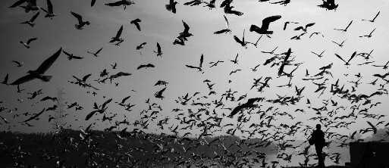
Flyways are established migration routes that birds follow, often along coastlines, mountains, or rivers, providing them with suitable stopover sites for rest and refueling.
Flyways

Slide 7
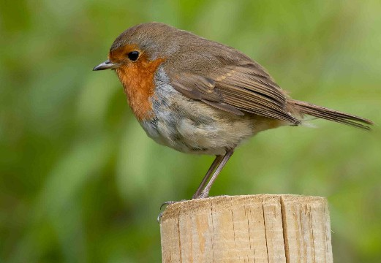
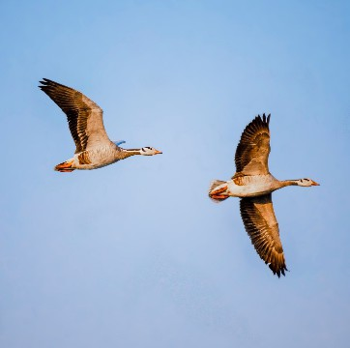
Timing of Migration
Birds time their migration based on various factors, including changes in daylight duration, food availability, and weather conditions in their breeding and non-breeding areas.

Slide 8
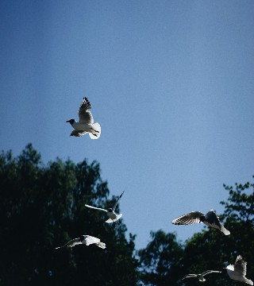
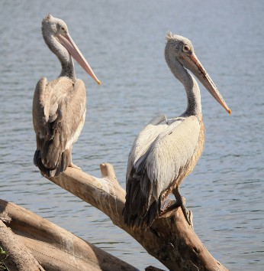
Migration Patterns
Birds exhibit diverse migration patterns, such as north-south, east-west, altitudinal, and circular migrations, depending on their species and geographic distribution.

Slide 9

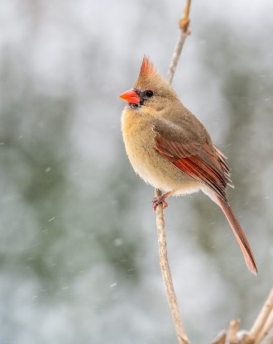
Migration Strategies
Birds employ different strategies during migration, including soaring, flapping flight, and utilizing favorable wind patterns to conserve energy and cover long distances.

Slide 10
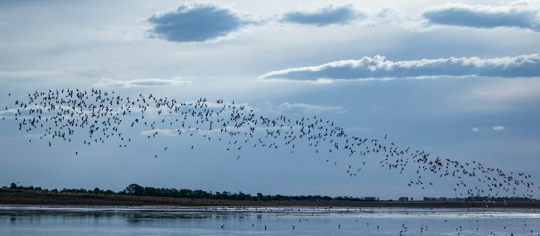
Cha lenges of Migration
Migration poses various challenges for birds, such as predation, weather extremes, exhaustion, and navigating unfamiliar territories, making it a risky endeavor.

Slide 11
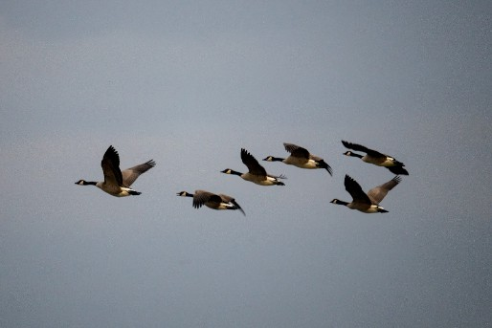
Birds rely on strategically located stopover sites along their migration routes, where they rest, replenish energy reserves, and engage in activities like feeding and socializing.
Stopover Sites

Slide 12
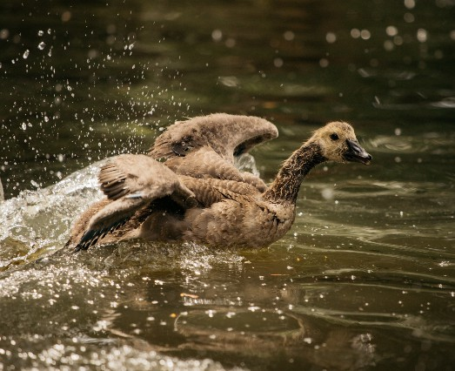
Migration and Breeding
Migration enables birds to reach their preferred breeding grounds, where they can find suitable nesting sites, mates, and optimal conditions for successful reproduction.

Slide 13
Bird migration showcases seasonal variation, with different species migrating during spring and autumn, while some undertake nomadic movements throughout the year.
Seasonal Variation

Slide 14
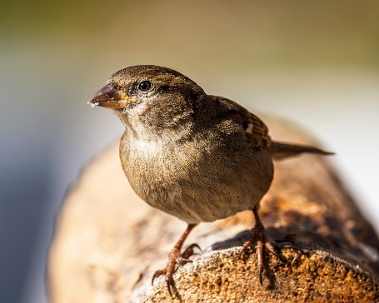
Conservation of Migratory Birds
Protecting critical habitats, preserving stopover sites, reducing threats like habitat loss, pollution, and illegal hunting are essential for the conservation of migratory bird populations.

Slide 15
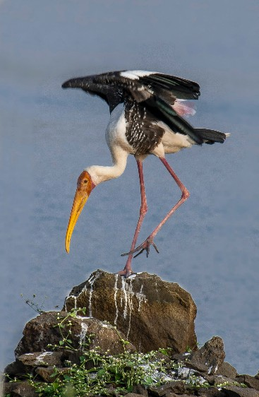
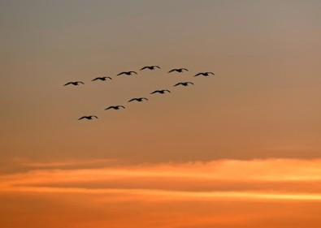
Climate change poses significant challenges to bird migration, as altering weather patterns, shifting food availability, and habitat changes can disrupt established migration patterns.
Impacts of Climate Change

